Slide 1
Unsupervised Learning
Clustering
IUT AI Student Chapter

Slide 2
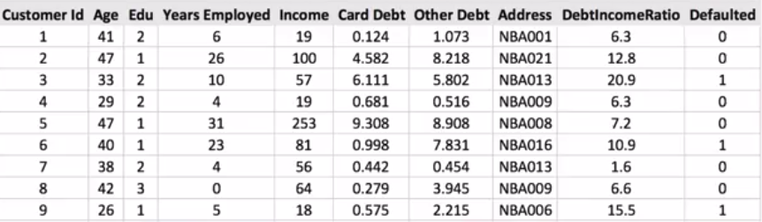
Customer Segmentation
Understanding different kinds of customers

Slide 3
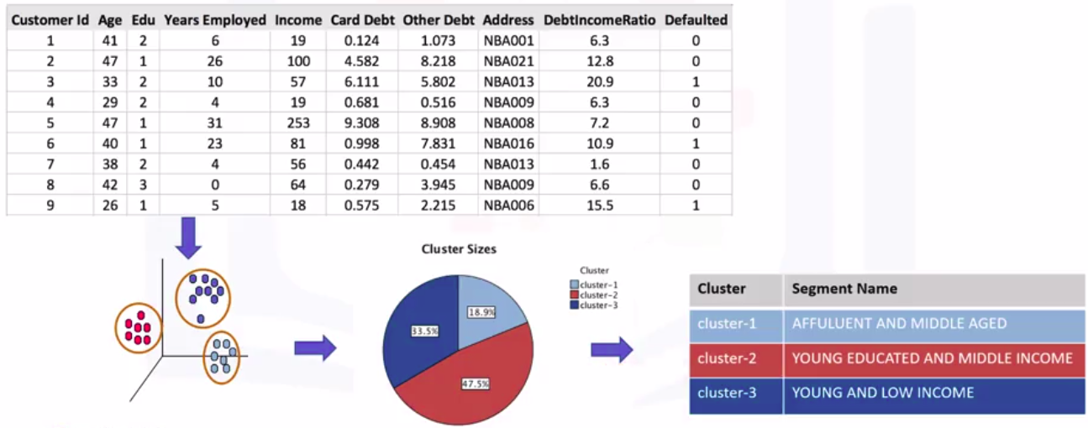
Customer Segmentation

Slide 4
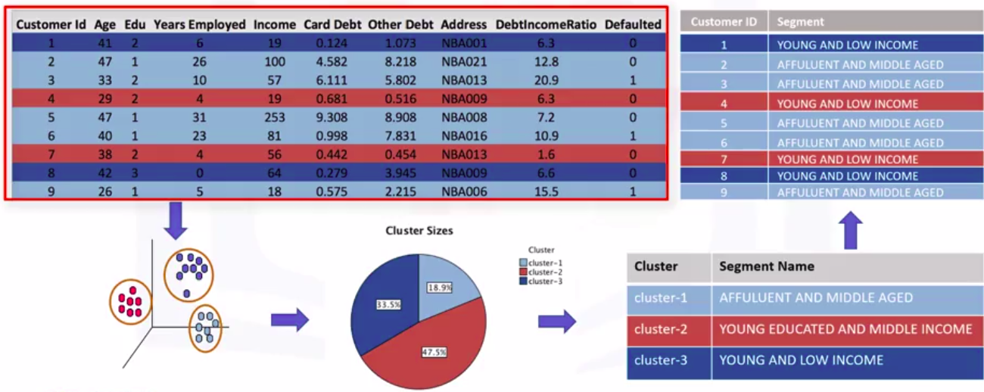
Customer Segmentation

Slide 5
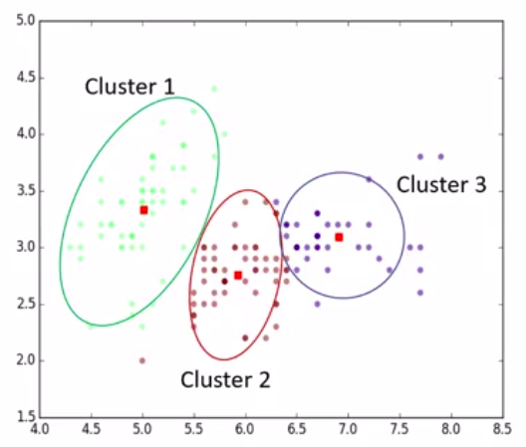
What is a cluster?
A group of objects that are similar to the other objects in the cluster, and dissimilar to data points in other clusters.

Slide 6
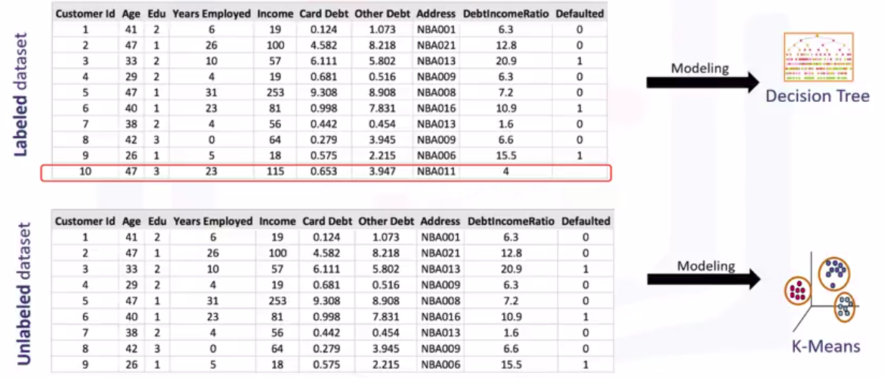
Classification vs. Clustering

Slide 7
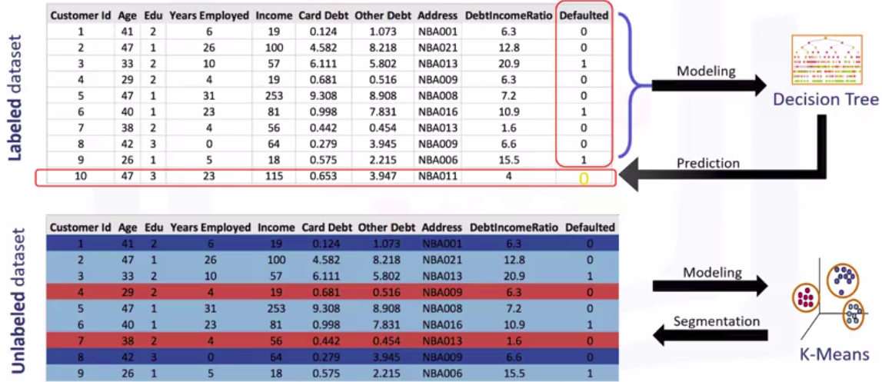
Classification vs. Clustering

Slide 8
Clustering Applications
Retail/Marketing
Identifying buying patterns of customers
Recommendation
Banking
Fraud detection in credit card use
Identifying clusters of customers
Insurance
Fraud detection in claim analysis
Insurance risk of customers

Slide 9
Clustering Applications
Publication
Auto-categorizing news based on their content
Recommending similar news articles
Medicine
Categorizing patient behavior
Biology
Clustering genetic markers to identify family ties

Slide 10
Why Clustering?
Exploratory data analysis
Summary generation
Outlier detection
Finding duplicates
Pre-processing step

Slide 11
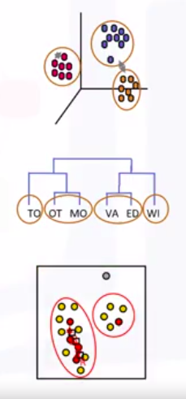
Clustering Algorithms
Partitioned-based Clustering
Relatively Efficient
E.g. K-Means, K-Median, Fuzzy cMeans
Hierarchical Clustering
Produces Trees of clusters
E.g. Agglomerative, Divisive
Density-based Clustering
Produces arbitrary shapes of clusters
E.g. DBSCAN

Slide 12
Partitioned-based Clustering
K-Means

Slide 13
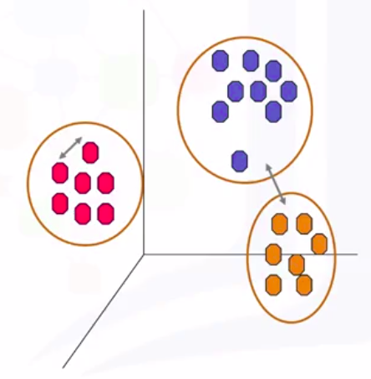
K-Means
K-means divides the data into non-overlapping subsets (clusters) without any cluster-internal structure
Data points within a cluster are very similar
Data points across different clusters are very different

Slide 14
Determine the similarity or dissimilarity
Minkowski Distance (l-p norm):
Where xi, xj are two l-dimensional data.

Slide 15
Minkowski Distance
L1 norm (p = 1) : Manhattan distance
L2 norm (p = 2): Euclidean distance

Slide 16
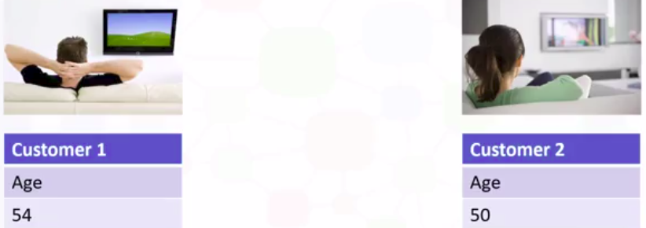
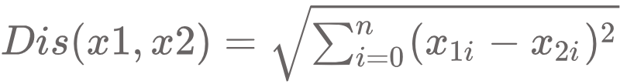
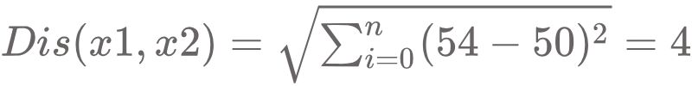
1-dimensional similarity/distance

Slide 17
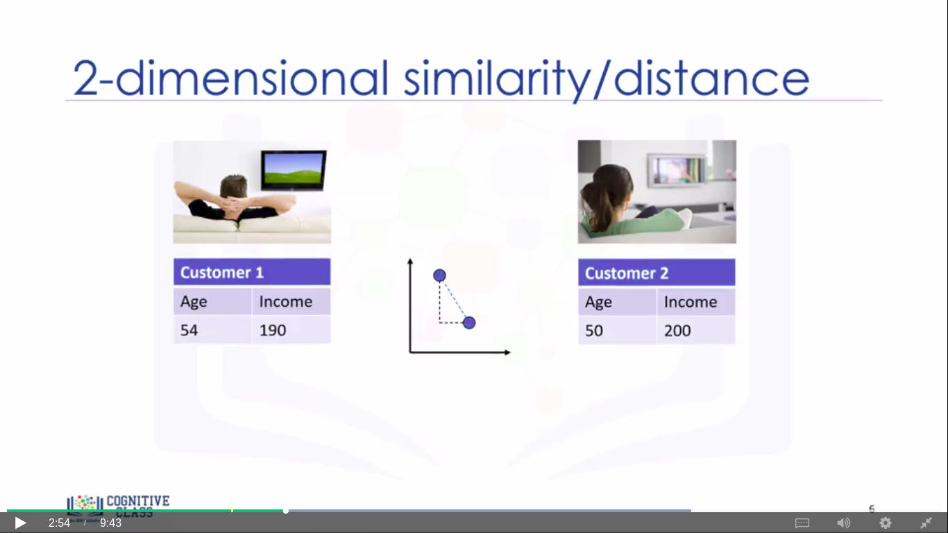
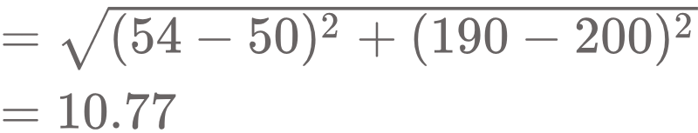
2-dimensional similarity/distance

Slide 18
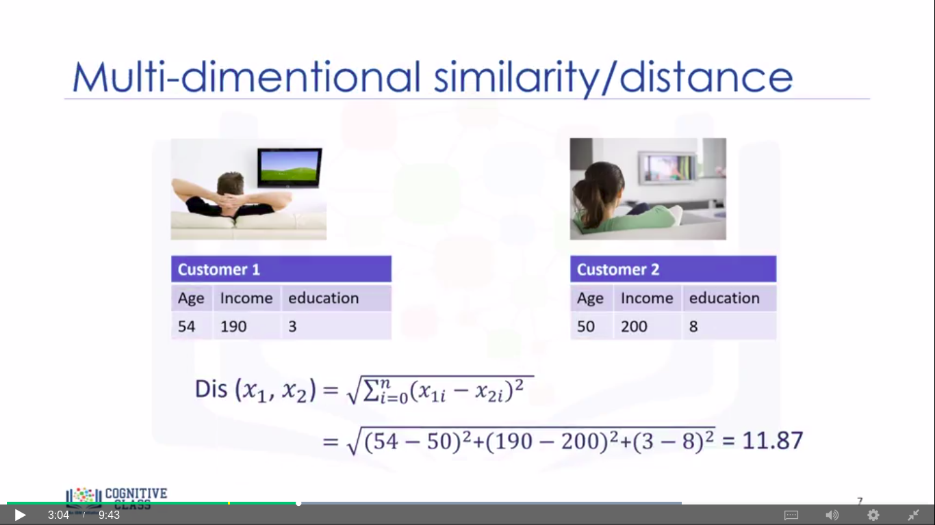
Multi-dimensional similarity/distance

Slide 19
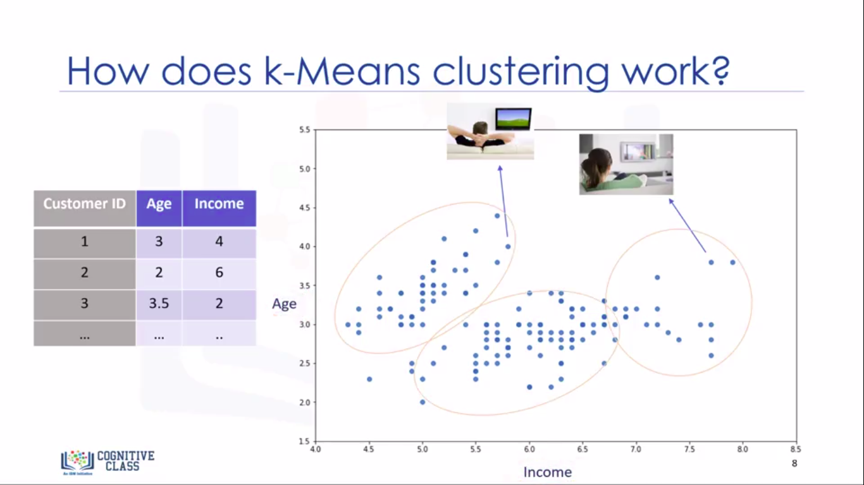
How does K-Means Clustering Work?

Slide 20
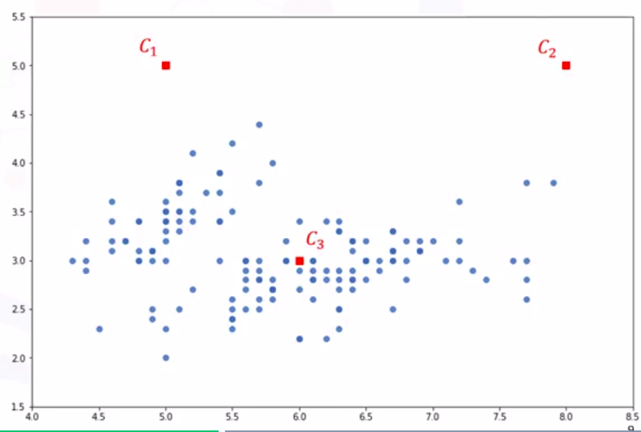
K-Means Clustering
Initialize k=3 centroids randomly

Slide 21
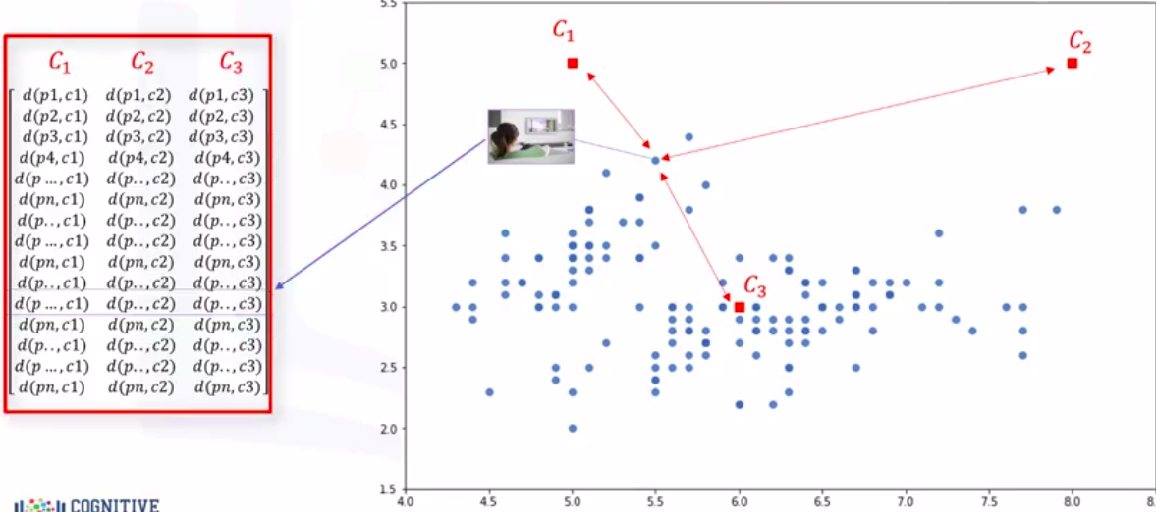
K-Means Clustering
2. Calculate Distance
Distance Matrix

Slide 22
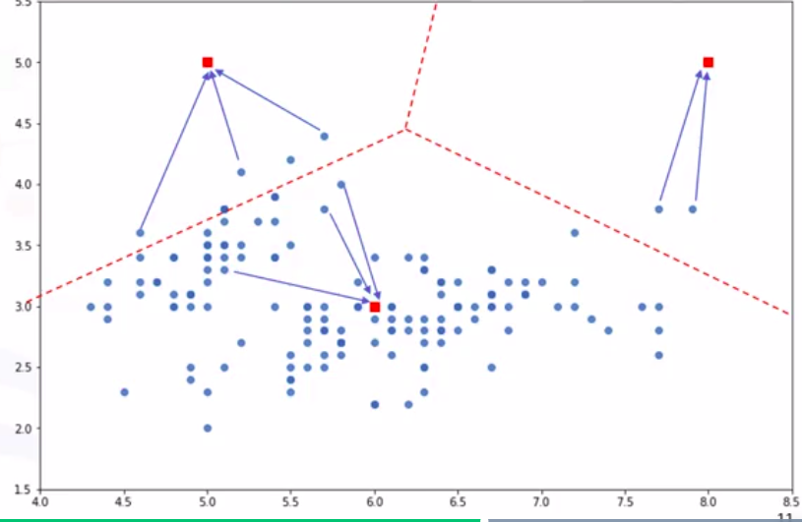
K-Means Clustering
3. Assign each point to the closest centroid

Slide 23
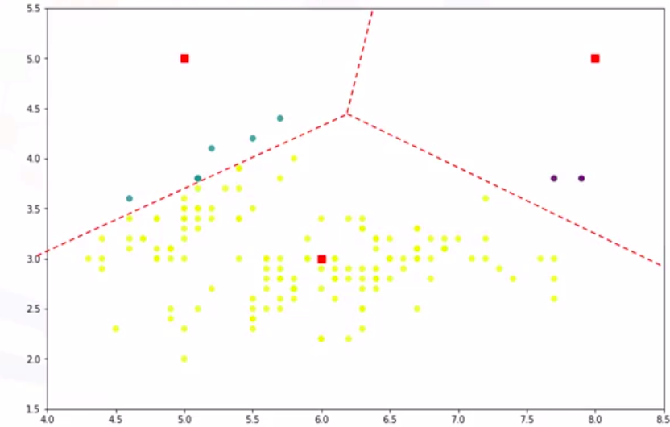
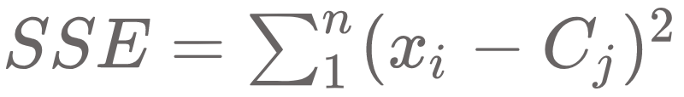
K-Means Clustering
SSE = Sum of the squared differences between each point and its centroid

Slide 24
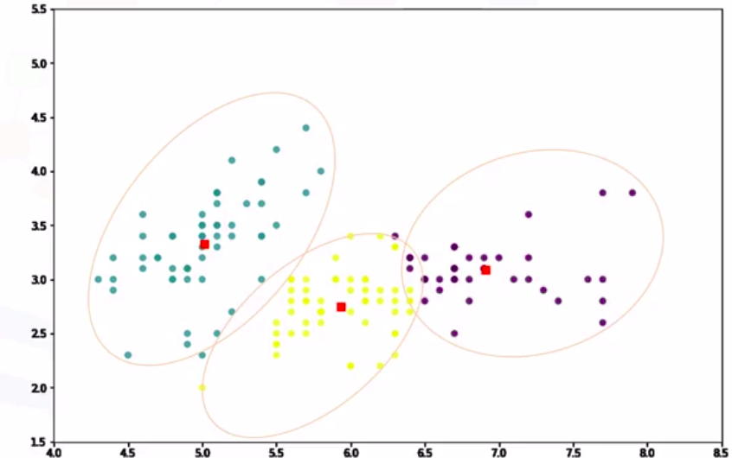
K-Means Clustering
4. Compute the new centroids
5. Repeat until there are no differences

Slide 25

K-Means Clustering

Slide 26
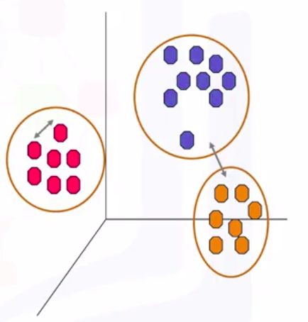
K-Means Accuracy
External Approach
Compare the clusters with the ground truth
Internal Approach
Average the distance between data points within a cluster

Slide 27
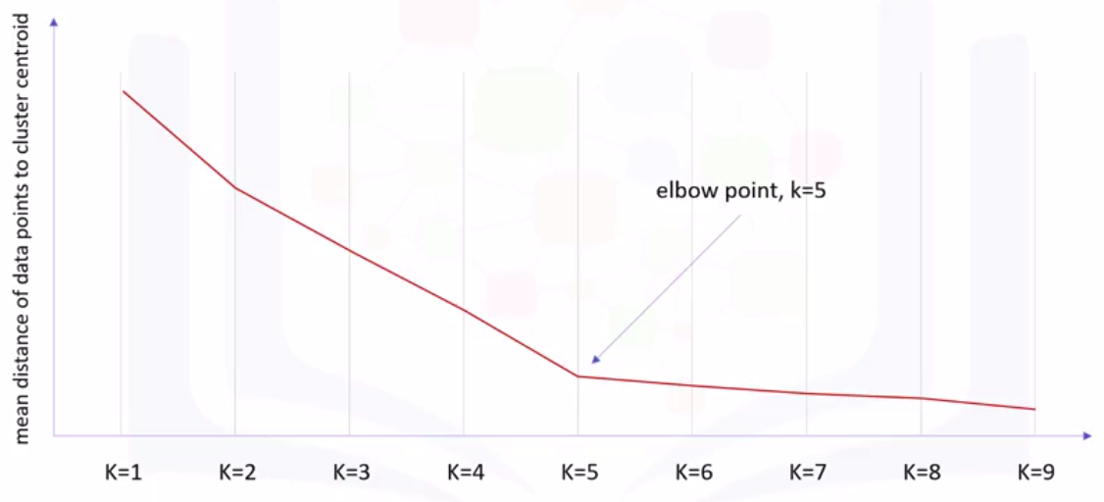
Choosing K

Slide 28
Hierarchical Clustering

Slide 29
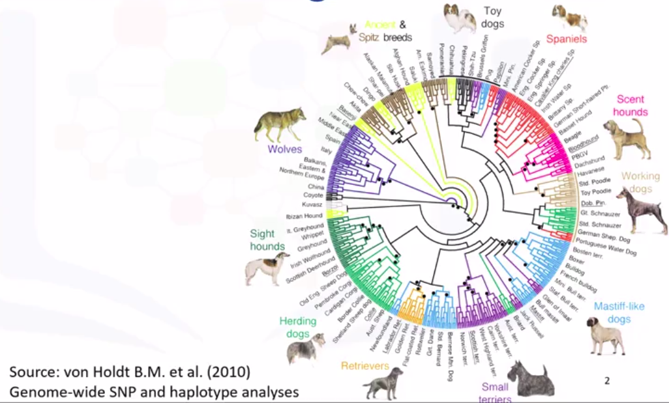
Hierarchical Clustering
Hierarchical clustering algorithms build a hierarchy of clusters where each node is a cluster consists of the clusters of its daughter nodes.
Notes:
An international team of scientists led by UCLA biologists used this dendrogram to report genetic data from more than 900 dogs from 85 breeds, and more than 200 wild gray wolves worldwide, including populations from North America, Europe, the Middle East and East Asia. They used molecular genetic techniques to analyze more than 48,000 genetic markers. This diagram shows hierarchical clustering of these animals based on the similarity in their genetic data

Slide 30
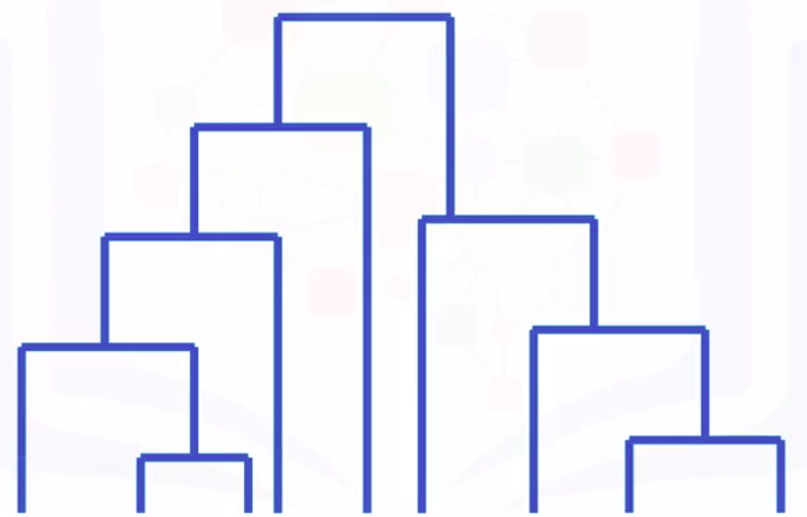
Hierarchical Clustering
Agglomerative
Divisive

Slide 31
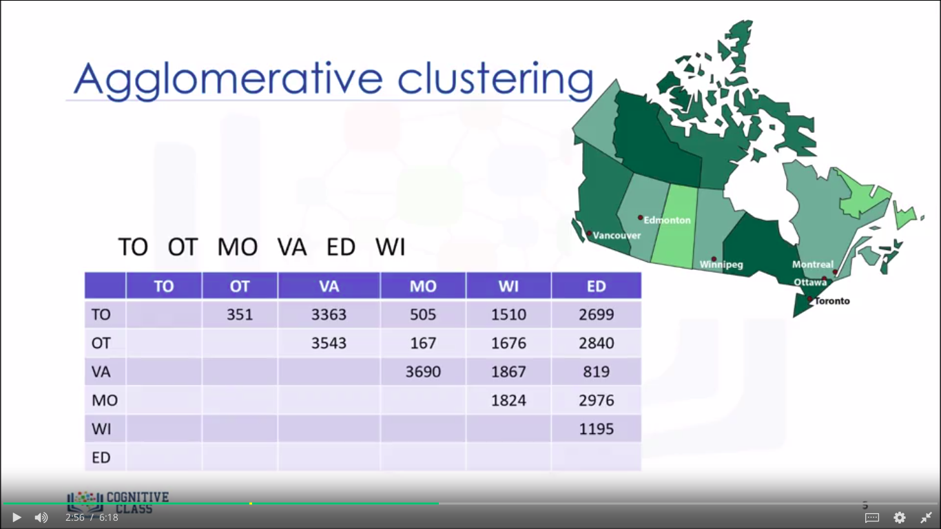
Agglomerative Clustering
TO
OT
MO
VA
ED
WI

Slide 32
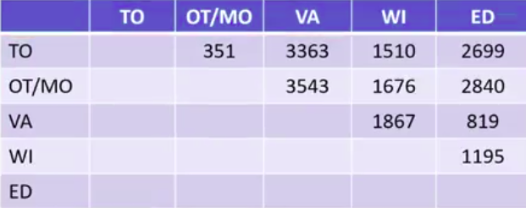
Agglomerative Clustering
TO
OT
MO
VA
ED
WI

Slide 33
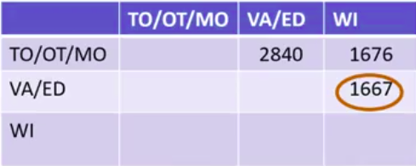
Agglomerative Clustering
TO
OT
MO
VA
ED
WI

Slide 34
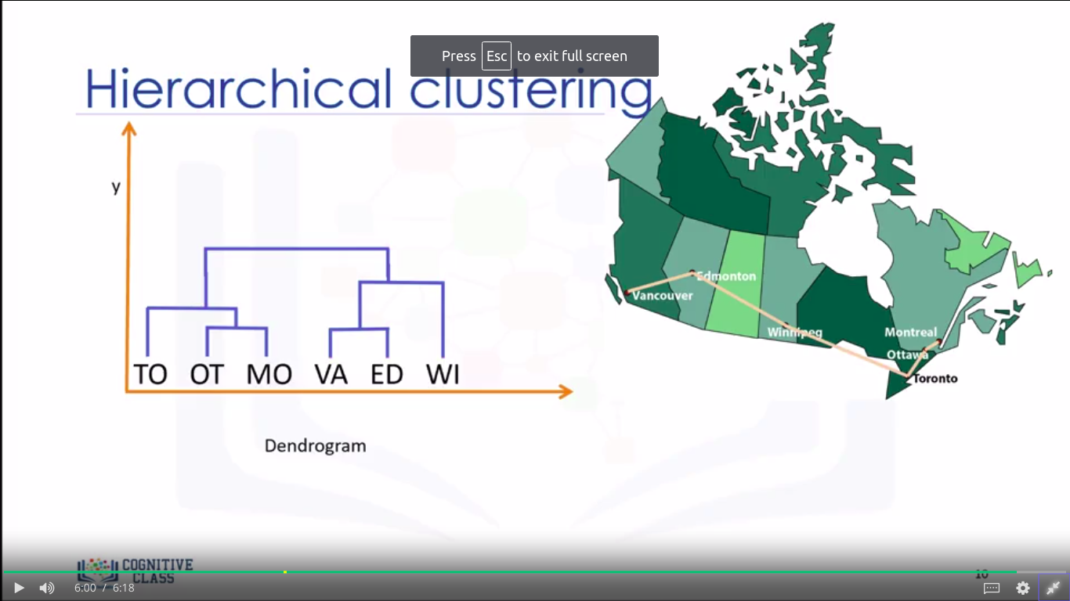
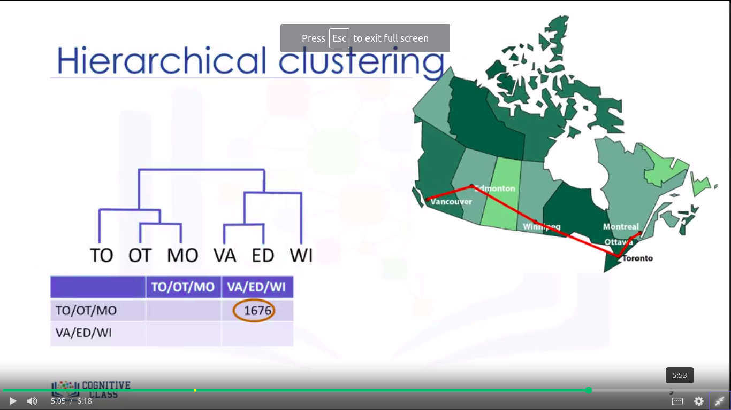
Agglomerative Clustering
TO
OT
MO
VA
ED
WI
Notes:
The y-coordinate of the horizontal line is the similarity of the two clusters that were merged where cities are viewed as singleton clusters.

Slide 35
Agglomerative Clustering
Create n clusters, one for each data point
Compute the proximity matrix
Repeat
Merge the two closest clusters
Update the proximity matrix
Until only a single cluster remains

Slide 36
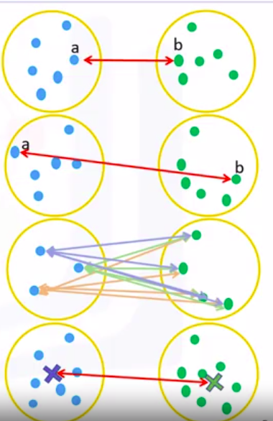
Distance Between Clusters
Single-Linkage Clustering
Minimum distance between clusters
Complete-Linkage Clustering
Maximum distance between clusters
Average Linkage Clustering
Average distance between clusters
Centroid Linkage Clustering
Distance between cluster centroids

Slide 37
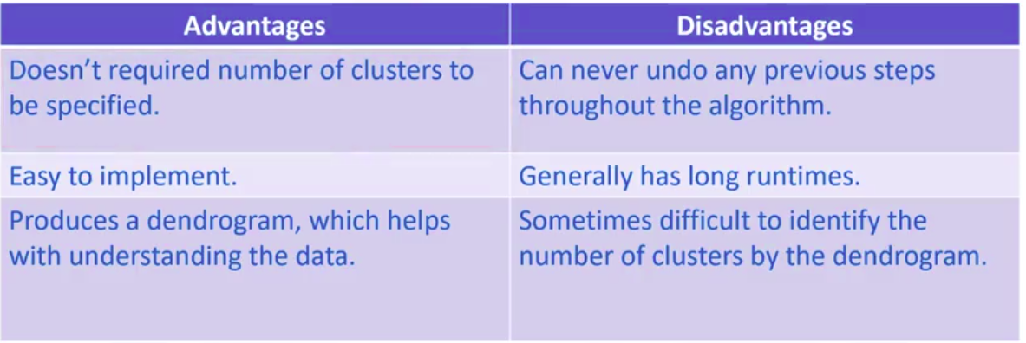
Advantages vs. Disadvantages

Slide 38
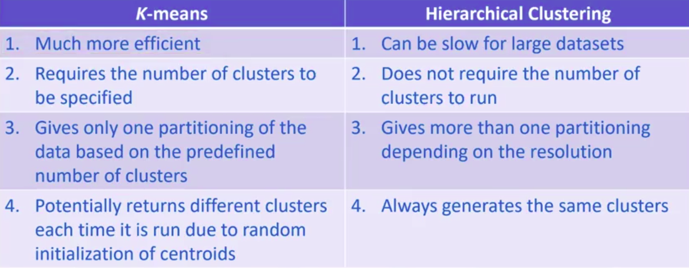
Hierarchical Clustering vs. K-Means

Slide 39
Density-based Clustering
DBSCAN

Slide 40
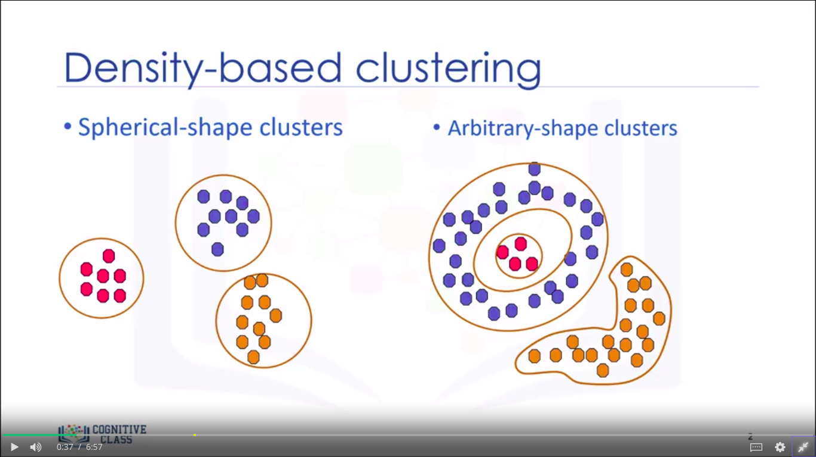
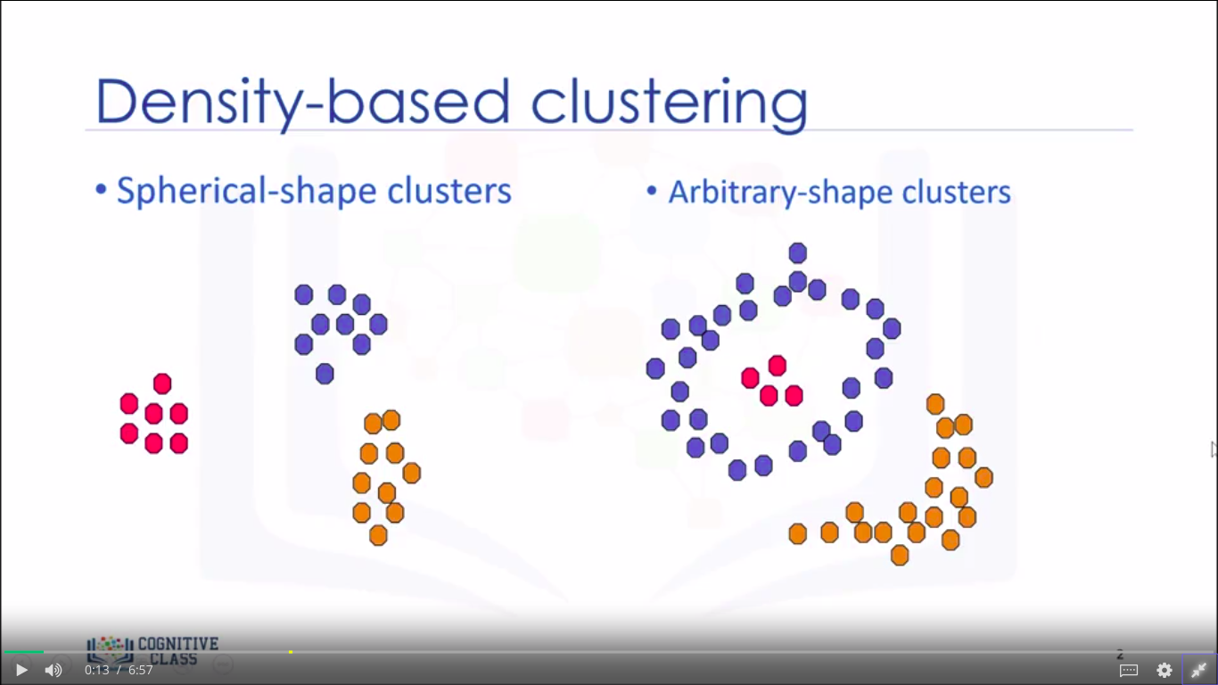
Density-based Clustering
Spherical-shape clusters
Arbitrary-shape clusters

Slide 41
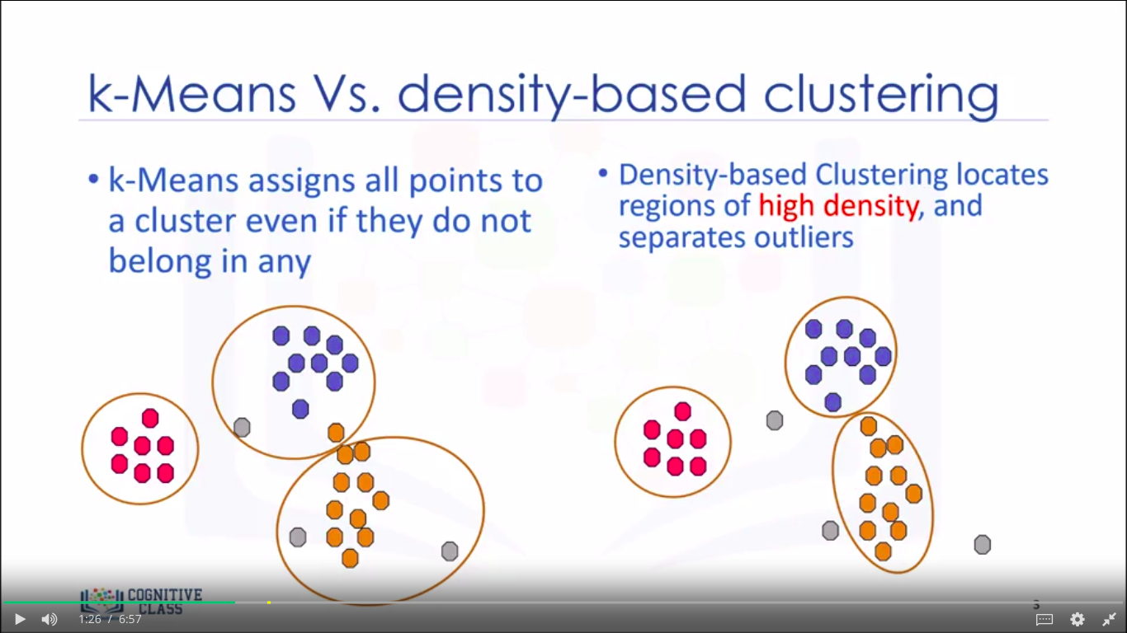
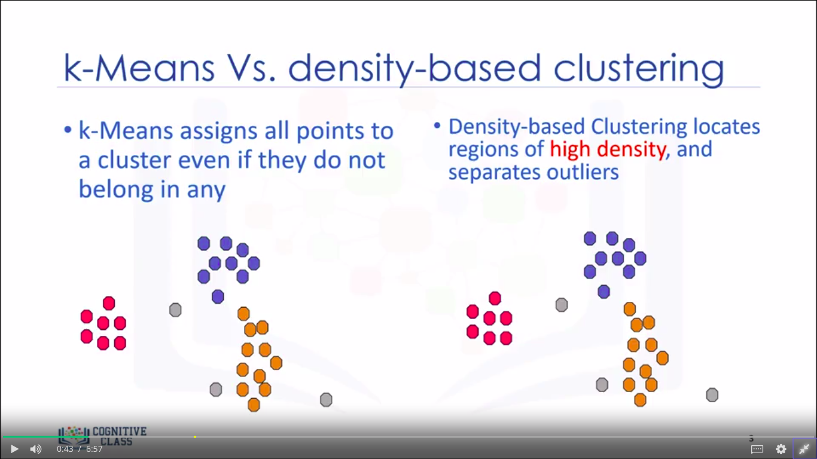
K-Means vs. Density-based Clustering
k-Means assigns each point to a cluster even if they don’t belong in any
Density-based clustering locates regions of high density, and separates outliers

Slide 42
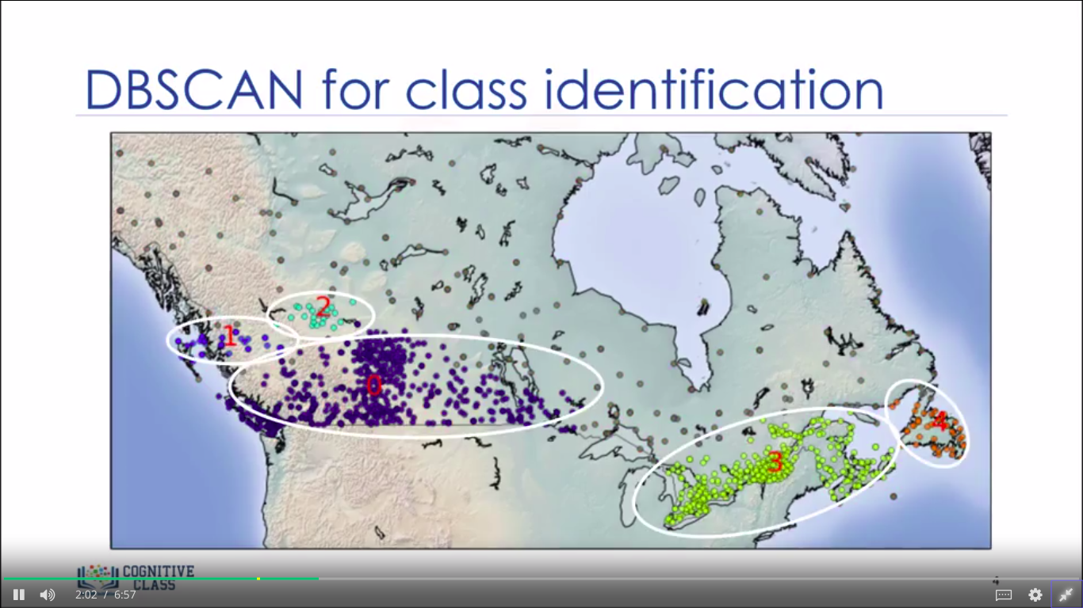
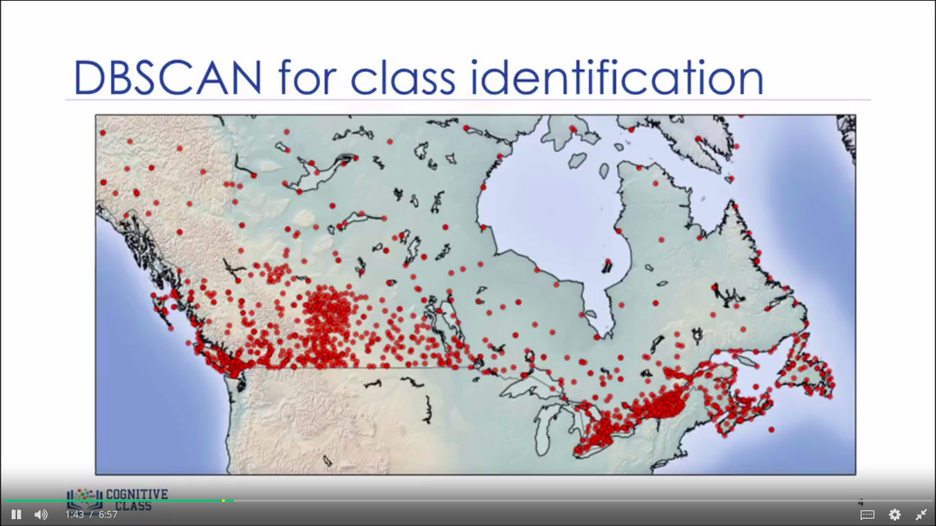
DBSCAN for class identification

Slide 43
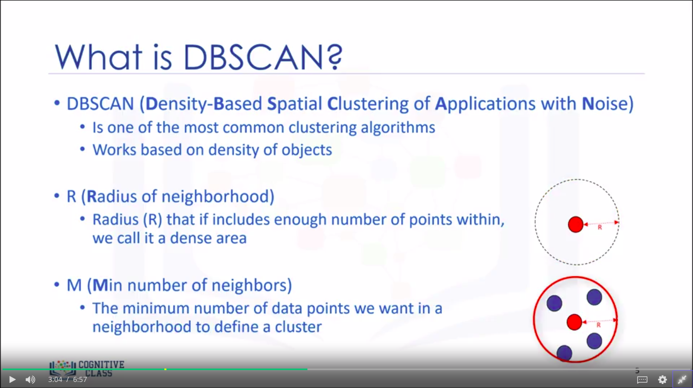
What is DBSCAN?
DBSCAN (Density-based Spatial Clustering of Applications with Noise)
Works based on density of objects
R (Radius of neighborhood)
Radius R that if includes enough number of points within, we call it a dense area
M (Minimum number of neighbors)
The minimum number of data points we want in a neighborhood to define a cluster

Slide 44
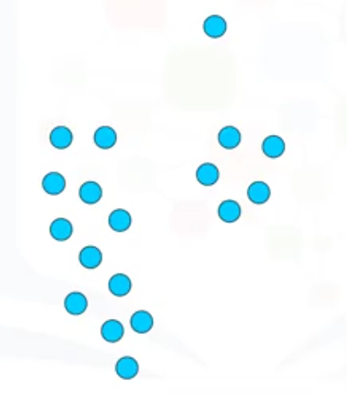
How DBSCAN works?
Each point is either a:
Core point
Border point
Outlier
R = 2 unit
M = 6 points

Slide 45
How DBSCAN works?
Core point: A data point is a core point if within our neighborhood of the point there are at least M points.
Border point: A data point is a border point if A; its neighbourhood contains less than M data points or B; it is reachable from some core point.
Outlier: An outlier is a point that is not a core point and also is not close enough to be reachable from a core point.

Slide 46
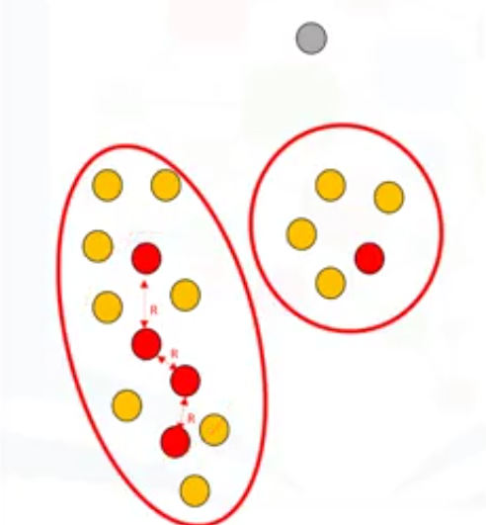
How DBSCAN works?
A cluster is formed as at least one core point plus all reachable core points plus all their borders.

Slide 47
Thanks to Saeed Aghabozorgi,
Machine Learning with python Course, Coursera

